Slide 1

Enhancing Machinery Management with Remote Monitoring
A comprehensive project report
Erikas valiukevicius
02/5/2024

Slide 2

Introduction
Empower
minimize
reduce
Importance of remote monitoring solutions:
Proactively identify and address potential issues before they escalate into costly breakdowns.
Optimize machinery usage and maintenance schedules to maximize efficiency and productivity.
Contribute to global sustainability efforts by reducing resource consumption and environmental pollution associated with machinery breakdowns.

Slide 3
Project Overview
Sensor Utilization:
ESP32 Microcontroller:
Employing various sensors such as temperature sensors, pressure level sensors, speed sensors, and impact sensors to gather crucial data about machinery performance and health.
Sensors play a vital role in detecting anomalies, predicting potential failures, and facilitating proactive maintenance.
The ESP32 microcontroller serves as the core component of the tracking device, facilitating interactions with sensors, communication with the MQTT broker, and data management.
Built-in Wi-Fi capabilities enable seamless connectivity to networks and interaction with cloud services, ensuring real-time monitoring and management.
Application Development:
Development of a comprehensive application that offers users a platform to manage all their owned machines and associated data.
The application serves as a user-friendly interface for accessing machine data, setting alerts, and taking proactive maintenance actions.

Slide 4
Motivation
Cost Reduction in Business Operations:
Enhanced Machinery Monitoring:
Implementing monitoring and tracking solutions offers a tangible opportunity to cut down unexpected repair costs resulting from machinery mismanagement.
By proactively identifying issues and implementing preventive maintenance measures, businesses can significantly reduce downtime and associated financial losses.
Remote monitoring solutions empower businesses to gain real-time insights into the health and performance of their machinery.
Early detection of anomalies and predictive analytics enable proactive measures, preventing breakdowns and optimizing machinery performance.
Environmental Considerations:
The global focus on sustainability and carbon neutrality highlights the importance of reducing resource consumption and environmental impact.
Machinery breakdowns not only lead to financial losses but also contribute to increased resource consumption and environmental pollution.
By implementing a robust monitoring system, businesses can efficiently manage machinery usage, reduce the frequency of repairs and replacements, and minimize their environmental footprint

Slide 5

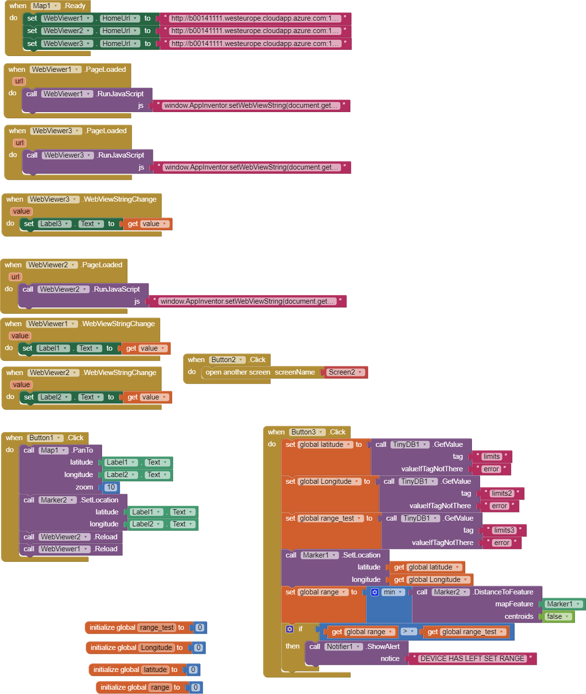
Background Research
Mit app inventor:
MIT App Inventor serves as a user-friendly web tool, offering an integrated development environment for creating software applications for the Android operating system. Its drag-and-drop interface allows users to design applications without delving into coding syntax, making it ideal for rapid prototyping and development. With pre-built components and functionalities, such as buttons, text boxes, sensors, and media playback, MIT App Inventor streamlines the app development process, prioritizing functionality and usability.

Slide 6

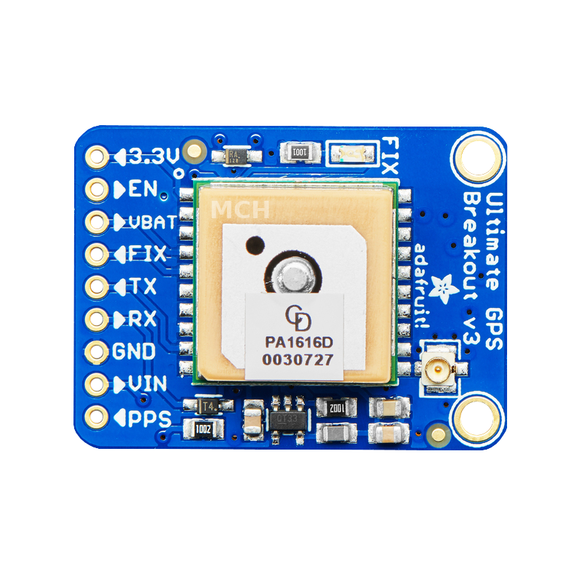
Background Research
GPS:
The Adafruit Ultimate GPS module offers precise location tracking data by receiving signals from satellites orbiting the Earth. With support for multiple satellite systems, including GPS, GLONASS, and Galileo, it provides accurate positioning information essential for real-time monitoring and tracking applications. By integrating the Adafruit Ultimate GPS module, the project ensures reliable and accurate location data for effective machinery management.

Slide 7

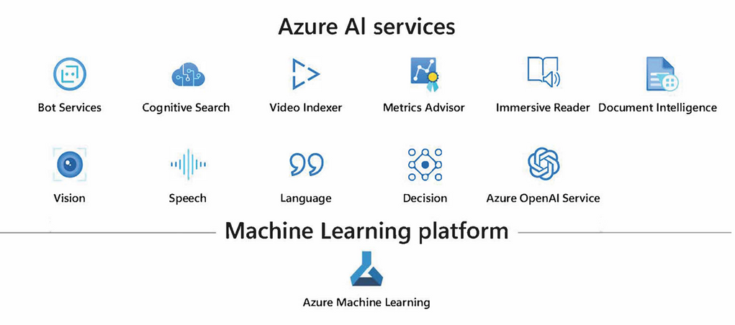
Background Research
Azure:
Microsoft Azure stands as a comprehensive computing platform offering a wide range of services, including computing capabilities, analytics tools, storage solutions, and networking features. Azure's robust infrastructure and platform services support IoT solutions, providing scalable data storage, analytics, and machine learning capabilities. By leveraging Azure IoT services, developers can build and deploy IoT solutions with ease, tapping into Azure's extensive ecosystem of tools and resources.

Slide 8
Background Research
Azure:
Microsoft Azure stands as a comprehensive computing platform offering a wide range of services, including computing capabilities, analytics tools, storage solutions, and networking features. Azure's robust infrastructure and platform services support IoT solutions, providing scalable data storage, analytics, and machine learning capabilities. By leveraging Azure IoT services, developers can build and deploy IoT solutions with ease, tapping into Azure's extensive ecosystem of tools and resources.

Slide 9

Thank you
someone@example.com

